Slide 1



Slide 2


01CE0410 – Computer Network
Unit - 5
Data Link Layer
Prof. Chirag Bhalodia
Computer Engineering Department

Slide 3


Outline
Data link layer services
Data link layer design issues
Framing
Error correction and Error Detection techniques
Flow Control
Error Control
Classification of Multiple access protocols
Random Access Protocols - CSMA , CSMA/CD, CSMA/CA
VLAN

Slide 4

Data Link Layer Services

Slide 5
Data Link Layer Services
Framing & Link access: Data Link Layer protocols encapsulate each network frame within a Link layer frame before the transmission across the link. A frame consists of a data field in which network layer datagram is inserted and a number of data fields. It specifies the structure of the frame as well as a channel access protocol by which frame is to be transmitted over the link.
Reliable delivery: Data Link Layer provides a reliable delivery service, i.e., transmits the network layer datagram without any error. A reliable delivery service is accomplished with transmissions and acknowledgements. A data link layer mainly provides the reliable delivery service over the links as they have higher error rates and they can be corrected locally, link at which an error occurs rather than forcing to retransmit the data.
Flow control: A receiving node can receive the frames at a faster rate than it can process the frame. Without flow control, the receiver's buffer can overflow, and frames can get lost. To overcome this problem, the data link layer uses the flow control to prevent the sending node on one side of the link from overwhelming the receiving node on another side of the link.

Slide 6
Data Link Layer Services
Error detection: Errors can be introduced by signal attenuation and noise. Data Link Layer protocol provides a mechanism to detect one or more errors. This is achieved by adding error detection bits in the frame and then receiving node can perform an error check.
Error correction: Error correction is similar to the Error detection, except that receiving node not only detect the errors but also determine where the errors have occurred in the frame.
Half-Duplex & Full-Duplex: In a Full-Duplex mode, both the nodes can transmit the data at the same time. In a Half-Duplex mode, only one node can transmit the data at the same time.

Slide 7
Data Link Layer Design Issues
Notes:
"issues" refers to various challenges, considerations, or factors that need to be addressed to ensure the efficient and reliable functioning of this layer. These issues encompass a range of concerns related to data transmission, error detection and correction, addressing, flow control, and network access control.

Slide 8
Data Link Layer Design Issues
Services provided to the network layer – The data link layer act as a service interface to the network layer. The principle service is transferring data from network layer on sending machine to the network layer on destination machine. This transfer also takes place via DLL (Data link-layer).
Frame synchronization – The source machine sends data in the form of blocks called frames to the destination machine. The starting and ending of each frame should be identified so that the frame can be recognized by the destination machine.
Flow control – Flow control is done to prevent the flow of data frame at the receiver end. The source machine must not send data frames at a rate faster than the capacity of destination machine to accept them.
Error control – Error control is done to prevent duplication of frames. The errors introduced during transmission from source to destination machines must be detected and corrected at the destination machine.

Slide 9
Framing

Slide 10
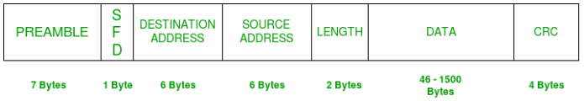
Framing
Framing is a function of the data link layer. It provides a way for a sender to transmit a set of bits that are meaningful to the receiver.
Ethernet, token ring, frame relay, and other data link layer technologies have their own frame structures. Frames have headers & trailers that contain information such as error-checking codes.
Ethernet frame format
There are two types of framing:
Fixed-size framing:
In this type of framing, there is no need for defining the boundaries of the frames.
ATM(Asynchronous Transfer Mode) is the example of fixed size framing.
Variable size framing:
In this type of framing, size of frame is defined in each frame.
Two methods used for this purpose:
Character oriented (Byte Stuffing)
Bit oriented (Bit Stuffing)
Notes:
In ATM, data is organized into fixed-size cells of 53 bytes each. This fixed-size cell structure provides predictable and deterministic latency, making it suitable for real-time applications such as voice and video transmission.
Advantages of Fixed-Size Framing:
Simplicity: Fixed-size framing simplifies frame extraction and processing at the receiver's end since the frame boundaries are predefined.
Efficiency: It can provide predictable and constant overhead, which is advantageous in scenarios where predictable latency and bandwidth allocation are essential.
Disadvantages of Fixed-Size Framing:
Inefficiency: Fixed-size framing may lead to inefficient bandwidth utilization, especially if the data payloads are smaller than the fixed frame size, resulting in wasted bandwidth.
Lack of Flexibility: Fixed-size framing may not be suitable for all types of data traffic, particularly for variable-length data streams where the overhead of fixed-size frames can be significant.

Slide 11
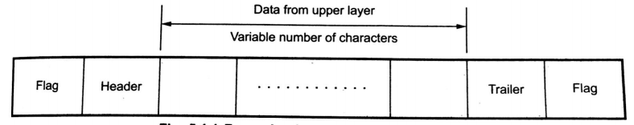
Framing
Character Oriented (Byte Oriented)
In this type, data to be carried are 8-bit characters from a coding system such as ASCII.
Header contains source and destinations address and other control information are also multiple of 8 bits.
Trailer contains error detection or error correction redundant bits are also multiple of 8 bits.

Slide 12
Framing
Character Oriented (Byte Oriented)
To separate one frame from the next, an 8-bit flag is added at the beginning and the end of a frame. The flag consists of protocol dependent special characters, signals the start or end of a frame.
Character oriented framing was suitable only for text data transmission. The flag could be selected to be any character not used for text communication.

Slide 13
Framing
Character Oriented (Byte Oriented)
When we send other types of information such as graph, audio and video, the flag could be part of the information. So it creates problem for receiver. When receiver encounters this pattern in the middle of the data, thinks it has reached the end of frame.
To solve this problem, a byte stuffing was used.
A special byte is added to the data section of the frame. When there is a character with the same pattern as flag. The data section is stuffed with an extra byte. This byte is usually called the Escape Character (ESC); which has a predefined pattern.

Slide 14
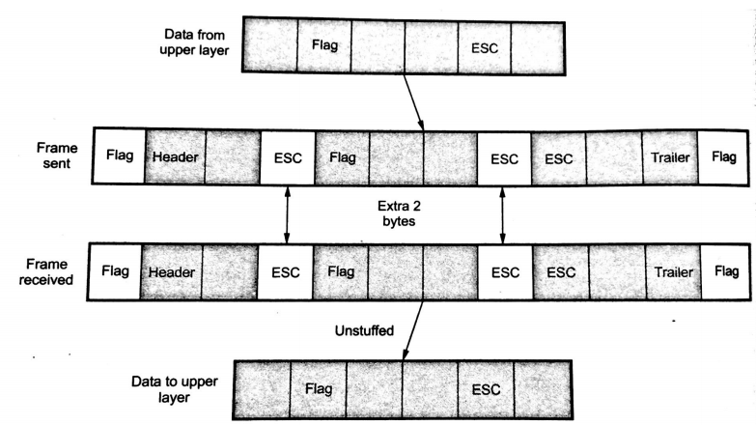
Framing
Character Oriented (Byte Oriented)
Whenever receiver encounters the ESC character, it removes it from the data section and treats the next character as data, not a delimiting flag.
If the escape character is part of the text an extra one is added to show that the second one part of the text. Following figure shows byte stuffing.

Slide 15
Framing
Bit Oriented
In this protocol, the data section of a frame is a sequence of bits to be interpreted by the upper layer as text, graphic, audio and video.
Most protocols use a special 8-bit pattern flag 01111110 as the delimiter to defined the beginning and the end of the frame.
In bit stuffing a specific bit is stuffed into the outgoing character stream. The format is as follows:
Each frame begins and ends with a special bit pattern, 01111110 called flag byte.
When five consecutive 1’s are encountered in the data, it automatically stuffs a ‘0’ bit into outgoing bit stream.

Slide 16
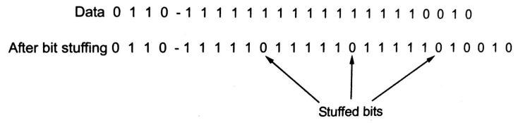
Framing
Bit Oriented
The format of the bit stuffing is as follow:

Slide 17
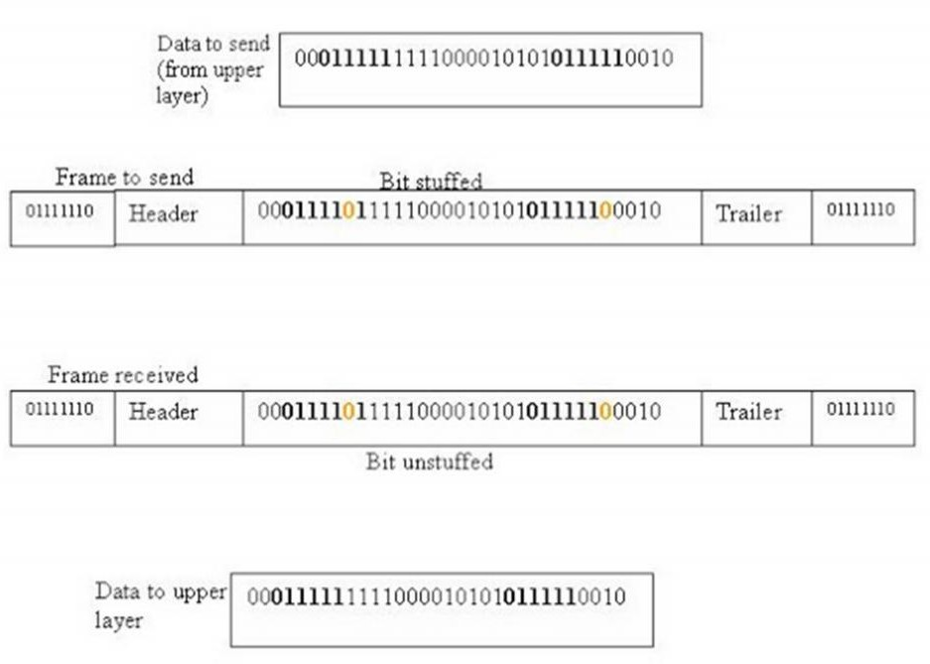
Framing
Bit Oriented
The format of the bit stuffing is as follow:

Slide 18
Error Detection Techniques

Slide 19


Error Detection
For reliable communication, errors must be detected and corrected.
A situation in which received information doesn’t match with the sender’s information.
At the time of transmission a digital signal may suffer from noise, that introduces errors in the data.
It means a 0 bit may change to 1 or a 1 bit may change to 0.
Data-link layer uses some error control mechanism to ensure that frames (data bit streams) are transmitted with certain level of accuracy.
Need to understand how errors is controlled and to know what types of errors may occur.
Error detection and correction are implemented either at the data link layer or the transport layer of the OSI model.

Slide 20
Coding and Error Control
Regardless of the design of the transmission system, there will be errors, resulting in the change of one or more bits in a transmitted frame.
Three approaches are used to deal with data transmission errors:
Error detection codes
Detects the presence of an error
Automatic repeat request (ARQ) protocols
Receiver discards a block of data in which an error is detected
Transmitter retransmits that block of data
Error correction codes, or forward correction codes
Designed to detect and correct errors
Avoiding the need for retransmission because retransmission is highly inefficient and error rates may be high.

Slide 21
Types of Error
Single Bit Error: In a frame, there is only one bit, anywhere though, which is corrupt.
Multi bit Error: Frame is received with more than one bits in corrupted state.
Burst Error: Frame contains more than1 consecutive bits corrupted.

Slide 22
Error Detection Technique
Error Detection Techniques
Parity Check
Cyclic Redundancy Check (CRC)
Checksum

Slide 23
Parity Check

Slide 24
Parity Check
A parity check is the process that ensures accurate data transmission between nodes during communication.
A parity bit is appended to the original data bits
Parity Check
Even Parity Check
no. of "1 bits" in the entire word is even.
Odd Parity Check
no. of "1 bits" in the entire word is odd.

Slide 25
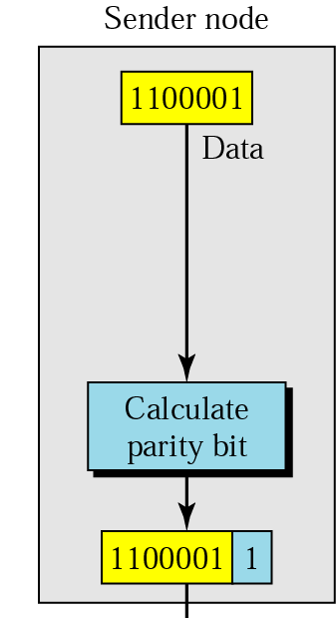
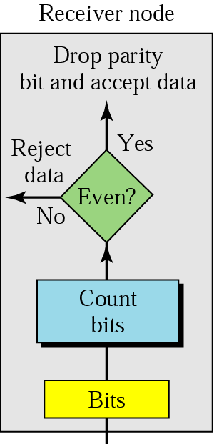
Error Detection in Parity Check
Parity checking at the receiver can be detected by the presence of an error if the parity of the receiver signal is different from the expected parity.
It means, if it is known that the parity of the transmitted signal is always going to be "even" and if the received signal has an odd parity, then the receiver can conclude that the received signal is not correct.
If an error is detected, then the receiver will ignore the received byte and request for retransmission of the same byte to the transmitter.
Drawback of parity check
If two (or any even number of bits are inverted due to errors), an undetected error occurs.
Transmission Medium

Slide 26
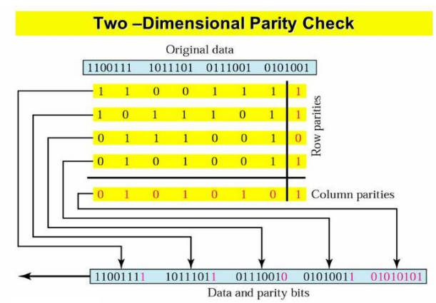
Error Detection in Parity Check

Slide 27
Cyclic Redundancy Check

Slide 28
Cyclic Redundancy Check
CRC or Cyclic Redundancy Check is a method of detecting accidental changes/errors in the communication channel.
CRC is based on binary division.
In CRC, a sequence of redundant bits, called cyclic redundancy check bits, are appended to the end of data unit so that the resulting data unit becomes exactly divisible by a second, predetermined binary number.
At the destination, the incoming data unit is divided by the same number. If at this step there is no remainder(zero remainder), the data unit is assumed to be correct and is therefore accepted.
A non-zero remainder indicates that the data unit has been damaged in transit and therefore must be rejected.

Slide 29
Cyclic Redundancy Check : Example
Quotient
Not used
Divisor
Dividend
Content of frame
Generator Polynomial
Remainder
Used for calculating checksum

Slide 30
Cyclic Redundancy Check : Example (Transmitter)
Given: Data=1101101
Divisor=10101 = X⁴ + X² + 1
Dividend (data+n-bit(0)) = 11011010000
n-bit->appending ‘0’-bit n times, where n is 1-bit less than divisor
0
1
1
1
1
1
1
10101
1 | 1 | 0 | 1 | 1 | 0 | 1 | 0 | 0 | 0 | 0
⊕
1 | 0 | 1 | 0 | 1
0
1
1
1
0
0
⊕
1 | 0 | 1 | 0 | 1
0
1
0
0
1
1
⊕
1 | 0 | 1 | 0 | 1
0
0
1
1
0
0
⊕
0 | 0 | 0 | 0 | 0
0
1
1
0
0
0
⊕
1 | 0 | 1 | 0 | 1
0
1
1
0
1
0
⊕
1 | 0 | 1 | 0 | 1
0
1
1
1
1
0
⊕
1 | 0 | 1 | 0 | 1
Remainder (CRC)= 1011
Now, at the receiver end, Remainder = 1011 is appended to Data=1101101
Therefore, Transmitter will send Data=11011011011
0
1
0
1
1

Slide 31
Cyclic Redundancy Check : Example (Receiver)
Given: Data Received= 11011011011
Divisor=10101
0
1
1
1
1
1
1
10101
1 | 1 | 0 | 1 | 1 | 0 | 1 | 1 | 0 | 1 | 1
⊕
1 | 0 | 1 | 0 | 1
0
1
1
1
0
0
⊕
1 | 0 | 1 | 0 | 1
0
1
0
0
1
1
⊕
1 | 0 | 1 | 0 | 1
0
0
1
1
0
1
⊕
0 | 0 | 0 | 0 | 0
0
1
1
0
1
0
⊕
1 | 0 | 1 | 0 | 1
0
1
1
1
1
1
⊕
1 | 0 | 1 | 0 | 1
0
1
0
1
0
1
⊕
1 | 0 | 1 | 0 | 1
Remainder = 00000
So, Data Accepted
0
0
0
0
0

Slide 32
Cyclic Redundancy Check : Error Example (Receiver)
Given: Data Received= 11011011011
Data Received= 11011001011
Divisor=10101
0
1
1
0
1
1
1
10101
1 | 1 | 0 | 1 | 1 | 0 | 0 | 1 | 0 | 1 | 1
⊕
1 | 0 | 1 | 0 | 1
0
1
1
1
0
0
⊕
1 | 0 | 1 | 0 | 1
0
1
0
0
1
0
⊕
1 | 0 | 1 | 0 | 1
0
0
1
1
1
1
⊕
0 | 0 | 0 | 0 | 0
0
1
1
1
1
0
⊕
1 | 0 | 1 | 0 | 1
0
1
0
1
1
1
⊕
1 | 0 | 1 | 0 | 1
0
0
0
1
0
1
⊕
0 | 0 | 0 | 0 | 0
Remainder = 0101 (which is non-zero)
So, Data Discarded
0
0
1
0
1

Slide 33
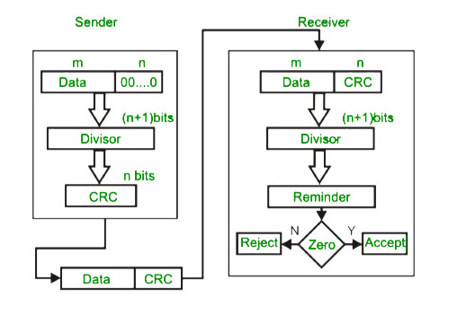
Cyclic Redundancy Check : Flowchart

Slide 34
Cyclic Redundancy Check : Exercise
Given: Data=1010000
Divisor=1001
Dividend (data+n-bit(0)) = 1010000000
n-bit->appending ‘0’-bit n times, where n is 1-bit less than divisor
ANS: CRC=011

Slide 35
Checksum

Slide 36
Checksum: Example
Frame 1 | 11001100
Frame 3 | 11110000
Given frames, where k=4 and m=8
Frame 2 | 10101010
Frame 4 | 11000011
Sender | Receiver
Frame 1: 1 1 0 0 1 1 0 0 Frame 2: 1 0 1 0 1 0 1 0 Ans:
Frame 1: 1 1 0 0 1 1 0 0 Frame 2: 1 0 1 0 1 0 1 0 Ans: Add carry-bit
1
1
1
1
+
+
+
0
1
1
1
0
1
1
0
+
0
1
1
1
0
1
1
0
Add carry-bit
1
1
1
1
1
1
1
1
1
1
1
1
1
0
1
1
1
1
1
1
0
1
1
1
0
0
Frame 3:
+
1 1 1 1 0 0 0 0
Frame 3:
+
1 1 1 1 0 0 0 0
1
1
1
1
1
1
1
1
0
0
1
1
1
1
1
0
0
1
1
1
0
0
Add carry-bit
+
1
Add carry-bit
+
1
1
1
1
1
+
0
1
1
0
1
0
0
0
+
0
1
1
0
1
0
0
0
Frame 4:
1 1 0 0 0 0 1 1
Frame 4:
1 1 0 0 0 0 1 1
1
1
1
1
Add carry-bit
0
0
1
0
1
0
1
1
Add carry-bit
0
0
1
0
1
0
1
1
+
1
+
1
0
0
1
0
1
1
0
0
0
0
1
0
1
1
0
0
1’s compliment
Checksum
1’s compliment
Checksum
+
1 1 0 1 0 0 1 1
0 0 0 0 0 0 0 0
1 1 0 1 0 0 1 1
1 1 1 1 1 1 1 1
Accept Data

Slide 37
Checksum : Exercise
Frame 1 | 10011001
Frame 3 | 00100100
Frame 2 | 11100010
Frame 4 | 10000100
Sum: 00100101
Checksum: 11011010

Slide 38
Error Correction Techniques

Slide 39
Block Error Correction Codes
Error Detection
and Correction
codes
FEC
(Forward Error Correction)
BEC
(Backward Error Correction)
Block Error Codes
Convolution Codes
ARQ
(Automatic Repeat Request)
Hamming Code
Cyclic Code

Slide 40
Hamming Code
Hamming code is a block code that is capable of detecting up to two simultaneous bit errors and correcting single-bit errors.
It was developed by R.W. Hamming for error correction.
In this coding method, the source encodes the message by inserting redundant bits within the message.
These redundant bits are extra bits that are generated and inserted at specific positions in the message itself to enable error detection and correction.
When the destination receives this message, it performs recalculations to detect errors and find the bit position that has error.

Slide 41
Hamming Code: Encoding a message
Step 1 − Calculation of the number of redundant bits.
Step 2 − Positioning the redundant bits.
Step 3 − Calculating the values of each redundant bit.

Slide 42

Hamming Code Example: Encoding
Data: m=1011001(7-bit)
The number of redundant bits can be calculated by: 2^{r} ≥ m + r + 1
where, r = redundant bit, m = data bit
Step-1: Calculate value of redundant bit(r)
Formula: 2^{r} ≥ m+r+1
2^{r} ≥ 7+r+1
Assuming r=3: 2³ ≥ 7+3+1
8 ≥ 11
Assuming r=4: 2⁴ ≥ 7+4+1
16 ≥ 12
Therefore, r=4
Step-3:
X

Slide 43
Hamming Code Example
Data: m=1011001(7-bit)
Step-2: Positioning the redundant bits
The r redundant bits placed at bit positions of powers of 2, i.e. 1, 2, 4, 8, 16 etc.
They are referred in the rest of this text as r₁ (at position 1), r₂ (at position 2), r₃ (at position 4), r₄ (at position 8) and so on.
Data-bit+ redundant-bit= 7-bit+4-bit=11-bit
Redundant bits= r1, r2, r4, r8
11 | 10 | 9 | 8 | 7 | 6 | 5 | 4 | 3 | 2 | 1
1
0
1
r8
1
0
0
r4
1
r2
r1

Slide 44
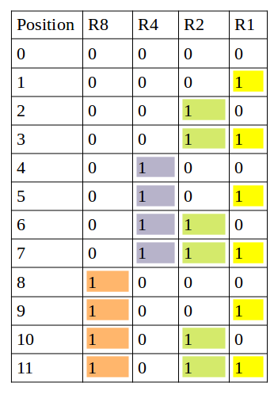
Hamming Code Example
Step-3: Calculating the values of each redundant bit
11 | 10 | 9 | 8 | 7 | 6 | 5 | 4 | 3 | 2 | 1
1
0
1
r8
1
0
0
r4
1
r2
r1
r1 | 1,3,5,7,9,11
r2 | 2,3,6,7,10,11
This example consider ‘EVEN PARITY’ bit
r4 | 4,5,6,7
r8 | 8,9,10,11

Slide 45
Hamming Code Example
Step-3: Calculating the values of each redundant bit
r1 | 1,3,5,7,9,11
11 | 10 | 9 | 8 | 7 | 6 | 5 | 4 | 3 | 2 | 1
r2 | 2,3,6,7,10,11
r4 | 4,5,6,7
1
0
1
r8
1
0
0
r4
1
r2
r1
r8 | 8,9,10,11
11
9
7
5
3
Even
Parity
r1
Value of r1=
1
1
1
0
1
0
11
10
7
6
3
Odd
Parity
r2
Value of r2=
1
0
1
0
1
1
7
6
5
Odd
Parity
r4
Value of r4=
1
0
0
1
11
10
9
Even
Parity
R8
Value of r8=
1
0
1
0
11 | 10 | 9 | 8 | 7 | 6 | 5 | 4 | 3 | 2 | 1
1
0
1
0
1
0
0
1
1
1
0

Slide 46
Hamming Code Example: Decoding
Step-4: decoding
11 | 10 | 9 | 8 | 7 | 6 | 5 | 4 | 3 | 2 | 1
1
0
1
0
1
0
0
1
1
1
0
11
9
7
5
3
1
Even
Parity
r1 | 1,3,5,7,9,11
r1=
0
r2 | 2,3,6,7,10,11
1
1
1
0
1
0
r4 | 4,5,6,7
11
10
7
6
3
2
Even
Parity
r2=
0
r8 | 8,9,10,11
1
0
1
0
1
1
7
6
5
4
Even
Parity
r4=
0
1
0
0
1
No Error
11
10
9
8
Even
Parity
r8=
0
1
0
1
0

Slide 47
Hamming Code Example: Encoding (Error)
Step-4: decoding
11 | 10 | 9 | 8 | 7 | 6 | 5 | 4 | 3 | 2 | 1
1
0
1
0
0
1
0
1
1
1
0
11
9
7
5
3
1
Even
Parity
r1 | 1,3,5,7,9,11
r1=
0
r2 | 2,3,6,7,10,11
1
1
1
0
1
0
r4 | 4,5,6,7
11
10
7
6
3
2
Odd
Parity
r2=
1
r8 | 8,9,10,11
1
0
1
1
1
1
7
6
5
4
Odd
Parity
r4=
1
1
1
0
1
11
10
9
8
Even
Parity
r8=
0
1
0
1
0
Value=0110=>6(binary)
Error detected in bit 6
Error will be corrected after changing bit 6 from ‘1’ to ‘0’

Slide 48
Hamming Code Example: Encoding (Error)
11 | 10 | 9 | 8 | 7 | 6 | 5 | 4 | 3 | 2 | 1
Step-4: decoding
1
0
1
0
0
0
0
1
1
1
0
11
9
7
5
3
1
Odd
Parity
r1 | 1,3,5,7,9,11
r1=
1
r2 | 2,3,6,7,10,11
1
1
0
0
1
0
r4 | 4,5,6,7
11
10
7
6
3
2
Odd
Parity
r2=
1
r8 | 8,9,10,11
1
0
0
0
1
1
7
6
5
4
Odd
Parity
r4=
1
0
0
0
1
11
10
9
8
Even
Parity
r8=
0
1
0
1
0
Value=0111=>7(binary)
Error detected in bit 7
Error will be corrected after changing bit 7 from ‘0’ to ‘1’

Slide 49
Hamming Code Example: Exercise
Data: 1 0 0 1 1 0 1
Data
1
0
0
1
1
0
1
Adding r1
1
0
0
1
1
0
1
1
Adding r2
1
0
0
1
1
0
1
0
1
Adding r4
1
0
0
1
1
0
0
1
0
1
Adding r8
1
0
0
1
1
1
0
0
1
0
1
Data: 1 0 0 1 1 1 0 0 1 0 1

Slide 50
Hamming Code Example: Exercise
Error in transmission:
Error bit Detection
Sent
Received
1
0
0
1
1
1
0
0
1
0
1
1
0
0
1
0
1
0
0
1
0
1
Error
11
10
9
8
7
6
5
4
3
2
1
1
0
0
1
0
1
0
0
1
0
1
11
10
9
8
7
6
5
4
3
2
1
1
0
0
1
0
1
0
0
1
0
1
11
10
9
8
7
6
5
4
3
2
1
1
0
0
1
0
1
0
0
1
0
1
11
10
9
8
7
6
5
4
3
2
1
1
0
0
1
0
1
0
0
1
0
1
The bit in position 7 is in error
0
1
1
1
7

Slide 51
Block Error Correction Codes
Error Detection
and Correction
codes
FEC
(Forward Error Correction)
BEC
(Backward Error Correction)
Block Error Codes
Convolution Codes
ARQ
(Automatic Repeat Request)
Hamming Code
Cyclic Code

Slide 52
Cyclic Code
The cyclic property of code words is that any cyclic-shift of a code word is also a codeword.
Cyclic codes follow this cyclic property
For a linear code C, if every code word i.e., C = C1,C2,......Cn from C has a cyclic right shift of components, it becomes a code word.
This shift of right is equal to n-1 cyclic left shifts. Hence, it is invariant under any shift.
So, the linear code C, as it is invariant under any shift, can be called as a Cyclic code.
Cyclic codes are used for error correction.
They are used to correct double errors and burst errors.

Slide 53
Cyclic Code
There are two important property of cyclic code
Property of Linearity
Property of Shifting

Slide 54
Cyclic Code: Example 1
Data = { 0000, 0110, 1001, 1111 }
Rule for Linearity:
A⊕B=C⊕D
A⊕C=B⊕D
B⊕C=A⊕D
A
B
C
D
A⊕B
C⊕D
 | 0 | 0 | 0 | 0
⊕ | 0 | 1 | 1 | 0
 | 0 | 1 | 1 | 0
 | 1 | 0 | 0 | 1
⊕ | 1 | 1 | 1 | 1
 | 0 | 1 | 1 | 0
=
A⊕C
B⊕D
 | 0 | 0 | 0 | 0
⊕ | 1 | 0 | 0 | 1
 | 1 | 0 | 0 | 1
 | 0 | 1 | 1 | 0
⊕ | 1 | 1 | 1 | 1
 | 1 | 0 | 0 | 1
Therefore, the Code is Linear
=
B⊕C
A⊕D
 | 0 | 1 | 1 | 0
⊕ | 1 | 0 | 0 | 1
 | 1 | 1 | 1 | 1
 | 0 | 0 | 0 | 0
⊕ | 1 | 1 | 1 | 1
 | 1 | 1 | 1 | 1
=

Slide 55
Cyclic Code: Example 1
Data = { 0000, 0110, 1001, 1111 }
Rule for Shifting: Cyclic right shifts
Right-shift A
A
B
C
D
0 | 0 | 0 | 0
Right-shift B
0 | 1 | 1 | 0
0 | 0 | 0 | 0
= A
0 | 0 | 1 | 1
=X
0 | 0 | 0 | 0
= A
Right-shift C
1 | 0 | 0 | 1
Right-shift D
1 | 1 | 1 | 1
1 | 1 | 0 | 0
= X
1 | 1 | 1 | 1
= D
1 | 1 | 1 | 1
=D
This code doesn’t follows one of the rule:
Rule for Linearity √
Rule for Shifting X
Therefore, this is NOT cyclic code

Slide 56
Cyclic Code: Example 2
Data = { 0000, 0101, 1010, 1111 }
Rule for Linearity:
A⊕B=C⊕D
A⊕C=B⊕D
B⊕C=A⊕D
A
B
C
D
A⊕B
C⊕D
 | 0 | 0 | 0 | 0
⊕ | 0 | 1 | 0 | 1
 | 0 | 1 | 0 | 1
 | 1 | 0 | 1 | 0
⊕ | 1 | 1 | 1 | 1
 | 0 | 1 | 0 | 1
=
A⊕C
B⊕D
 | 0 | 0 | 0 | 0
⊕ | 1 | 0 | 1 | 0
 | 1 | 0 | 1 | 0
 | 0 | 1 | 0 | 1
⊕ | 1 | 1 | 1 | 1
 | 1 | 0 | 1 | 0
Therefore, the Code is Linear
=
B⊕C
A⊕D
 | 0 | 1 | 0 | 1
⊕ | 1 | 0 | 1 | 0
 | 1 | 1 | 1 | 1
 | 0 | 0 | 0 | 0
⊕ | 1 | 1 | 1 | 1
 | 1 | 1 | 1 | 1
=

Slide 57
Cyclic Code: Example 2
Data = { 0000, 0101, 1010, 1111 }
Rule for Shifting:
Right-shift A
A
B
C
D
0 | 0 | 0 | 0
Right-shift B
0 | 1 | 0 | 1
0 | 0 | 0 | 0
= A
1 | 0 | 1 | 0
= C
0 | 0 | 0 | 0
= A
0 | 1 | 0 | 1
=B
1 | 0 | 1 | 0
= C
Right-shift C
1 | 0 | 1 | 0
Right-shift D
1 | 1 | 1 | 1
0 | 1 | 0 | 1
= B
1 | 1 | 1 | 1
= D
1 | 0 | 1 | 0
= C
1 | 1 | 1 | 1
=D
0 | 1 | 0 | 1
= B
This code follows both:
Rule for Linearity
Rule for Shifting
Therefore, this is cyclic code

Slide 58
Cyclic Code: Example 2 (Wrong Example)
Data Sent = { 0000, 0101, 1010, 1111 } Data Received = { 0001, 0101, 1010, 1111 }
Rule for Linearity:
A⊕B=C⊕D
A⊕C=B⊕D
B⊕C=A⊕D
A
B
C
D
A⊕B
C⊕D
 | 0 | 0 | 0 | 1
⊕ | 0 | 1 | 0 | 1
 | 0 | 1 | 0 | 0
 | 1 | 0 | 1 | 0
⊕ | 1 | 1 | 1 | 1
 | 0 | 1 | 0 | 1
≠
A⊕C
B⊕D
 | 0 | 0 | 0 | 1
⊕ | 1 | 0 | 1 | 0
 | 1 | 0 | 1 | 1
 | 0 | 1 | 0 | 1
⊕ | 1 | 1 | 1 | 1
 | 1 | 0 | 1 | 0
Therefore, the Code is NOT Linear
≠
B⊕C
A⊕D
 | 0 | 1 | 0 | 1
⊕ | 1 | 0 | 1 | 0
 | 1 | 1 | 1 | 1
 | 0 | 0 | 0 | 1
⊕ | 1 | 1 | 1 | 1
 | 1 | 1 | 1 | 0
≠

Slide 59
Cyclic Code: Example 2
Data = { 0000, 0101, 1010, 1111 } Data Received = { 0001, 0101, 1010, 1111 }
Rule for Shifting:
Right-shift A
A
B
C
D
0 | 0 | 0 | 1
Right-shift B
0 | 1 | 0 | 1
1 | 0 | 0 | 0
= X
1 | 0 | 1 | 0
= C
0 | 1 | 0 | 0
= X
0 | 1 | 0 | 1
=B
1 | 0 | 1 | 0
= C
Right-shift C
1 | 0 | 1 | 0
Right-shift D
1 | 1 | 1 | 1
0 | 1 | 0 | 1
= B
1 | 1 | 1 | 1
= D
1 | 0 | 1 | 0
= C
1 | 1 | 1 | 1
=D
0 | 1 | 0 | 1
= B
Therefore, from both the property we can conclude that
Error is present in Block -A

Slide 60
Feature of Cyclic Code
The cyclic codes have a very good performance in detecting
single-bit errors
double errors
odd number of errors
burst errors
They can easily be implemented in hardware and software.
They are especially fast when implemented in hardware.

Slide 61
Automatic Repeat Request (ARQ): Types
ARQ Protocols
Stop-and-wait
ARQ
Go-back-N
ARQ
Selective Repeat
ARQ

Slide 62
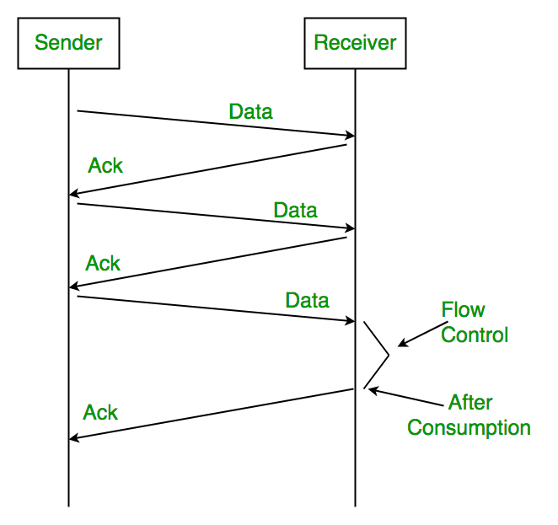
Stop-and-Wait ARQ
Stop – and – wait ARQ provides unidirectional data transmission with flow control and error control mechanisms, appropriate for noisy channels.
The sender keeps a copy of the sent frame.
It then waits for a finite time to receive a positive acknowledgement from receiver.
If the timer expires, the frame is retransmitted.
If a positive acknowledgement is received then the next frame is sent.

Slide 63
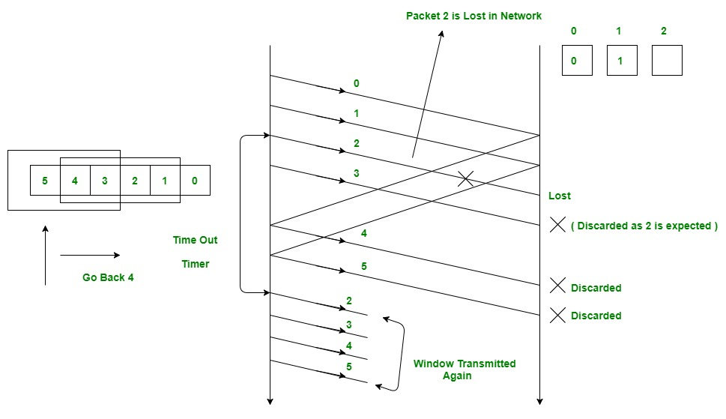
Go-back-N ARQ
Go – Back – N ARQ provides for sending multiple frames before receiving the acknowledgement for the first frame.
It uses the concept of sliding window, and so is also called sliding window protocol.
The frames are sequentially numbered and a finite number of frames are sent.
If the acknowledgement of a frame is not received within timeout period, all frames starting from that frame are retransmitted.

Slide 64
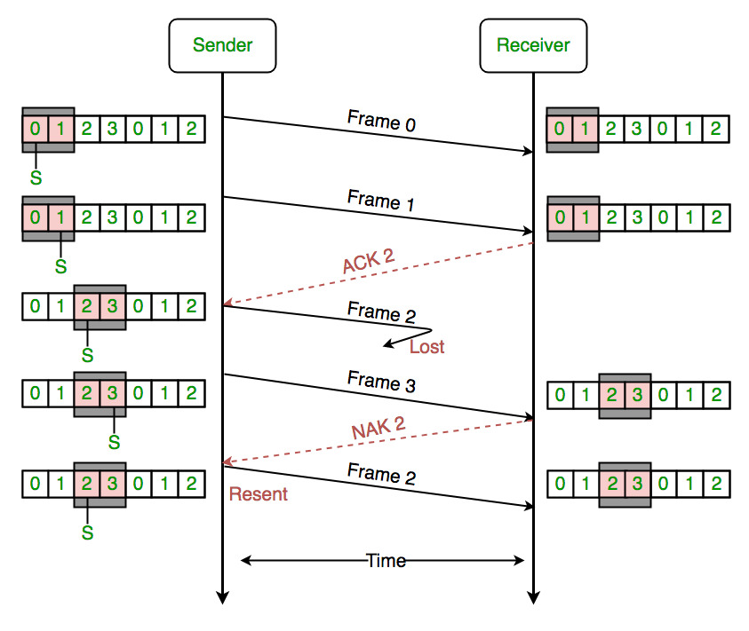
Selective Repeat ARQ
Selective Repeat ARQ also provides for sending multiple frames before receiving the acknowledgement for the first frame.
However, here only the erroneous or lost frames are retransmitted, while the good frames are received and buffered.

Slide 65
Flow Control

Slide 66
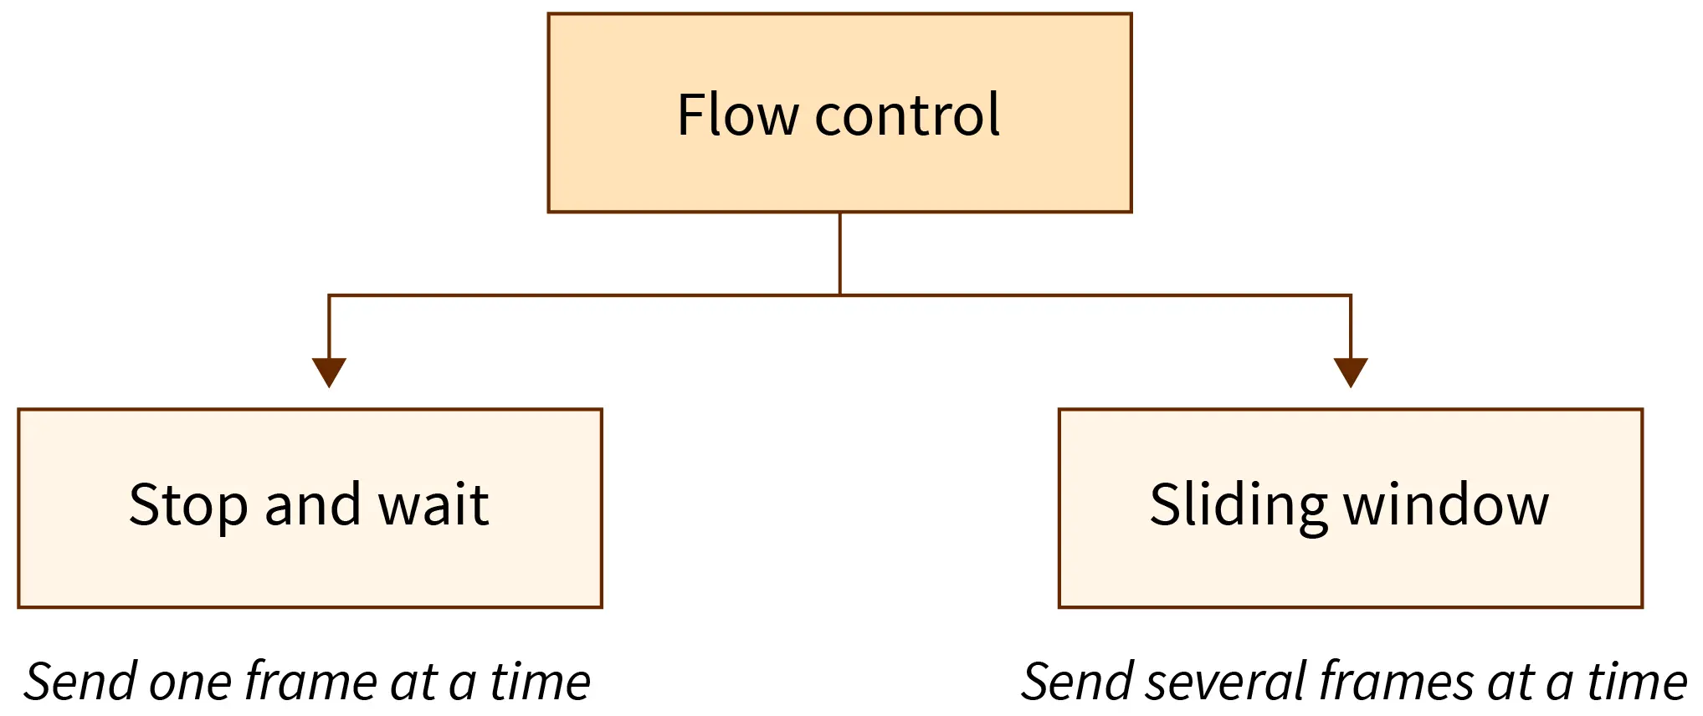
Flow Control
Already Studied in Unit 3

Slide 67
Error Control

Slide 68
Error Control
ARQ Protocols
Stop-and-wait
ARQ
Go-back-N
ARQ
Selective Repeat
ARQ
Already Studied in Unit 3 & 5

Slide 69
Classification of Multiple Access Protocol

Slide 70
Classification of Multiple Access Protocol
Multiple access protocols are a set of protocols operating in the Medium Access Control sublayer (MAC sublayer) of the Data Link Layer of Open Systems Interconnection (OSI) model.
The objectives of multiple access protocols are optimization of transmission time, minimization of collisions and avoidance of crosstalk's.

Slide 71
Classification of Multiple Access Protocol
Classification of Multiple Access Protocol
Random Access Protocol
Aloha
CSMA
CSMA/CD
CSMA/CA
Controlled Access Protocol
Reservation
Polling
Token Passing
Channelization Methods
FDMA
TDMA
CDMA
Multiple Access Protocol
Controlled Access Protocol
Reservation
FDMA
Random Access Protocol
Aloha
CSMA
CSMA/CD
CSMA/CA
Polling
Token Passing
Channelization Methods
TDMA
CDMA

Slide 72
Random Access Protocol

Slide 73
CSMA
CSMA – Carrier Sense Multiple Access.
Carrier Sense Multiple Access ensures fewer collisions as the station is required to first sense the medium (for idle or busy) before transmitting data.
If it is idle then it sends data, otherwise it waits till the channel becomes idle.
However there is still chance of collision in CSMA due to propagation delay.
For example, if station A wants to send data, it will first sense the medium. If it finds the channel idle, it will start sending data. However, by the time the first bit of data is transmitted (delayed due to propagation delay) from station A, if station B requests to send data and senses the medium it will also find it idle and will also send data. This will result in collision of data from station A and B.

Slide 74
CSMA
CSMA access modes-
1-persistent: The node senses the channel, if idle it sends the data, otherwise it continuously keeps on checking the medium for being idle and transmits unconditionally(with 1 probability) as soon as the channel gets idle.
Non-Persistent: The node senses the channel, if idle it sends the data, otherwise it checks the medium after a random amount of time (not continuously) and transmits when found idle.
P-persistent: The node senses the medium, if idle it sends the data with p probability. If the data is not transmitted ((1-p) probability) then it waits for some time and checks the medium again, now if it is found idle then it send with p probability. This repeat continues until the frame is sent. It is used in Wifi and packet radio systems.

Slide 75
CSMA/CD
CSMA/CD – Carrier Sense Multiple Access with Collision Detection.
If two stations sense the channel to be idle and begin transmitting simultaneously, they will both detect the collision almost immediately.
Rather than finish transmitting their frames, which are irretrievably (not retrieved) garbled (reproduce) anyway, they should abruptly stop transmitting as soon as the collision is detected.
Quickly terminating damaged frames saves time and bandwidth.
This protocol, known as CSMA/CD (CSMA with Collision Detection) is widely used on LANs in the MAC sublayer.
CSMA/CD, as well as many other LAN protocols, uses the conceptual model of Figure.

Slide 76
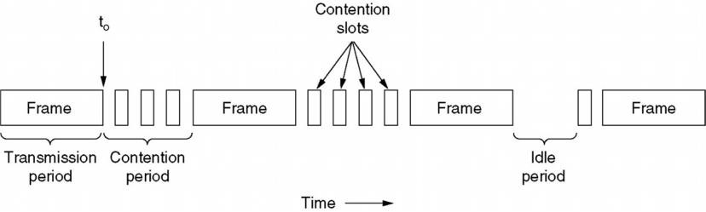
CSMA/CD
At the point marked t0, a station has finished transmitting its frame.
Any other station having a frame to send may now attempt to do so. If two or more stations decide to transmit simultaneously, there will be a collision.
Collisions can be detected by looking at the power or pulse width of the received signal and comparing it to the transmitted signal.

Slide 77
CSMA/CD
After a station detects a collision, it aborts its transmission, waits a random period of time, and then tries again, assuming that no other station has started transmitting in the meantime.
Therefore, model for CSMA/CD will consist of alternating contention and transmission periods, with idle periods occurring when all stations are quiet (without any activity).

Slide 78
CSMA/CA
CSMA/CA – Carrier Sense Multiple Access with Collision Avoidance.
The process of collisions detection involves sender receiving acknowledgement signals.
If there is just one signal(its own) then the data is successfully sent but if there are two signals(its own and the one with which it has collided) then it means a collision has occurred.
To distinguish between these two cases, collision must have a lot of impact on received signal. However it is not so in wired networks, so CSMA/CA is used in this case.

Slide 79
CSMA/CA
CSMA/CA avoids collision by:
Interframe space – Station waits for medium to become idle and if found idle it does not immediately send data (to avoid collision due to propagation delay) rather it waits for a period of time called Interframe space or IFS. After this time it again checks the medium for being idle. The IFS duration depends on the priority of station.
Contention Window – It is the amount of time divided into slots. If the sender is ready to send data, it chooses a random number of slots as wait time which doubles every time medium is not found idle. If the medium is found busy it does not restart the entire process, rather it restarts the timer when the channel is found idle again.
Acknowledgement – The sender re-transmits the data if acknowledgement is not received before time-out.

Slide 80
VLAN

Slide 81
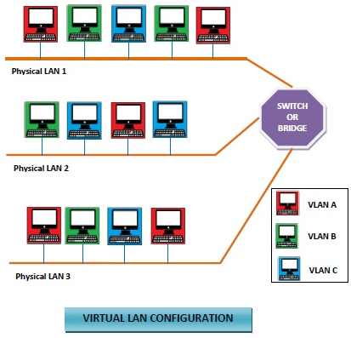
VLAN
Virtual Local Area Networks or Virtual LANs (VLANs) are a logical group of computers that appear to be on the same LAN irrespective of the configuration of the underlying physical network.
Network administrators partition the networks to match the functional requirements of the VLANs so that each VLAN comprise of a subset of ports on a single or multiple switches or bridges.
This allows computers and devices in a VLAN to communicate in the simulated environment as if it is a separate LAN.

Slide 82
VLAN
Features of VLANs
A VLAN forms sub-network grouping together devices on separate physical LANs.
VLAN's help the network manager to segment LANs logically into different broadcast domains.
VLANs function at layer 2, i.e. Data Link Layer of the OSI model.
Using VLANs, network administrators can easily partition a single switched network into multiple networks depending upon the functional and security requirements of their systems.
VLANs eliminate the requirement to run new cables or reconfiguring physical connections in the present network infrastructure.
VLANs help large organizations to re-partition devices aiming improved traffic management.
VLANs also provide better security management allowing partitioning of devices according to their security criteria.

Slide 83
VLAN
Types of VLANs
There are 3 types of VLAN
Protocol VLAN − Here, the traffic is handled based on the protocol used. A switch or bridge segregates, forwards or discards frames that come to it based upon the traffics protocol.
Port-based VLAN − This is also called static VLAN. Here, the network administrator assigns the ports on the switch / bridge to form a virtual network.
Dynamic VLAN − Here, the network administrator simply defines network membership according to device characteristics.
VLAN
Protocol VLAN
Port-based VLAN
Dynamic VLAN

Slide 84

Thank
You

